Slide 1


SAP UI5 & FIORI with OData TRAINING using BAS
Anubhav Oberoy
Day – 16

Slide 2
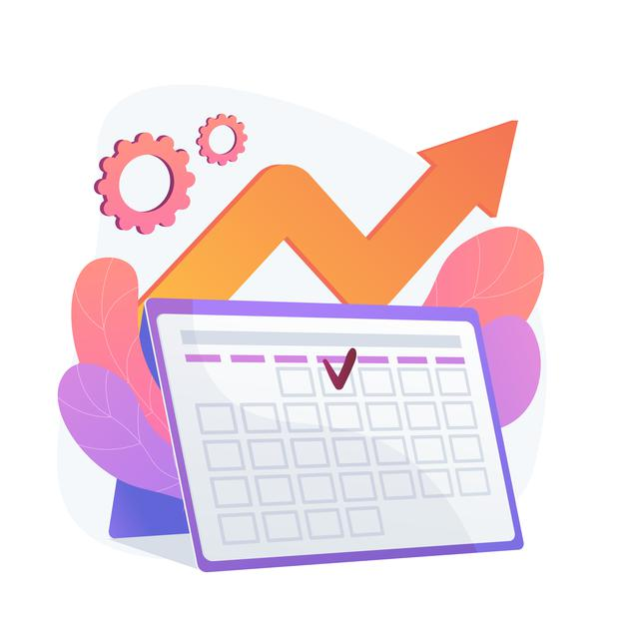
Agenda – Day 16
Introduction to Router
Routing Configuration
Route Match Handler
Icon Tab Bar
Responsive Table (sap.m.Table)
Drill Down using the Table
Messages in UI5
Drop Down
Object Status
Fragments
Different Ways of loading fragment
Value Help Popup
What is OData?
oData Basics.
Structure of Odata.
Client Side Query With Odata.
Get Operations.
SAP Deployment Options
TCodes and Services
Data Model for our use case
Creating OData Service.
Building Get Entity set Method
Testing the Get Entity set Method in Browser
Building Get Entity method (Single Product)
Introduction to the Postman Tool
Setting the Authorization in Postman
Testing Get Entity and Entity set using Postman
Implementing Create in OData Service
Testing POST calls in the SAP Logon
Testing POST calls using postman
How to set payload in postman to test POST call
Introduction to x-csrf-token
Implementing Update and Delete in service
Adding Supplier Entity set
Introduction to Association
Associating Supplier Set to Product Set
Introduction to Function Import
Creating a Function to get Most expensive product
Basics of Connectivity
Introduction to Cloud Connector
Steps to Setup the Cloud Connection.
Creating the destination in the BTP for BAS
Creating the destination in the Vscode

Slide 3

Performance Issues in our Fiori App
We have used sap.ui.view API to create the object of the view, but it seems that the API is obsolete. Then what is the right way to instantiate our view?
All the view objects are instantiated when app starts, whether we want or not. If user does not navigate to a view, still the view object is getting created. This is a misuse of computation power and slow down our app when number of views are increased/high.
For each view, we are writing more and more code to create object, multiple developers will add this code in different place, because of this the maintenance will be come very expensive even the handover will be very hard.
The browser navigation button (back) is not working properly.
When the refresh of app happens, the application should restore the state of the UI. It should not start all over again. So user will not frustrate applying all the filters again.
When we take a URL of the page and share with colleagues/friends/family, when they open same URL, Eventually they should see the same state of application what I see. Basically we should restore the state of UI as it is in our system.
Router

Slide 4
Router
Router is an object which is provided by SAP UI5 Component (UIComponent).
It is responsible for creating our view objects on demand.
It is also responsible for complete app navigation based on pattern (end point, hash tag).
How to use router:
Get the router object form the UIComponent class.
Call initialize method using the object
The initialize method will SCAN manifest.json to find the routing configuration (mandatory).
Add the routing configuration in manifest.json
rootView – base view we want to load
config – base configuration like view type, path of all views etc.
routes – array of all the targets, patterns and route names
targets – put all the end point target with views which needs to be instantiated and nav.
Sap.m.routing.Router is the class used for Routing and Navigation purpose in SAP UI5 framework.
“Pattern” defines the hashtag that needs to be added at the end of the URL when it is hit.
“name” defines a unique name for the particular route.
“target” defines the target which is defined in targets section

Slide 5
Routing Configuration
Routing Configuration is defined in manifest.json file. It is defined under the “sap.ui5” section.
Routing configuration consists of routes, targets, config, and owner.
rootView
config
routes
targets
This section contains the information about our Root View. The View which works as a container for other views. In this section we provide the path of the view, type and controlId.
This section contains the global router configuration and default values that apply for all routes and targets. We define the router class that we want to use and where our views are located in the app.
Each route defines a name, a pattern, and one or more targets to navigate to when the route has been hit.
Three subsections :-
1. pattern
2. name
3. target
A target defines a view that is or more routes displayed, it is associated with one.
Subsections: -
Overview
detail

Slide 6
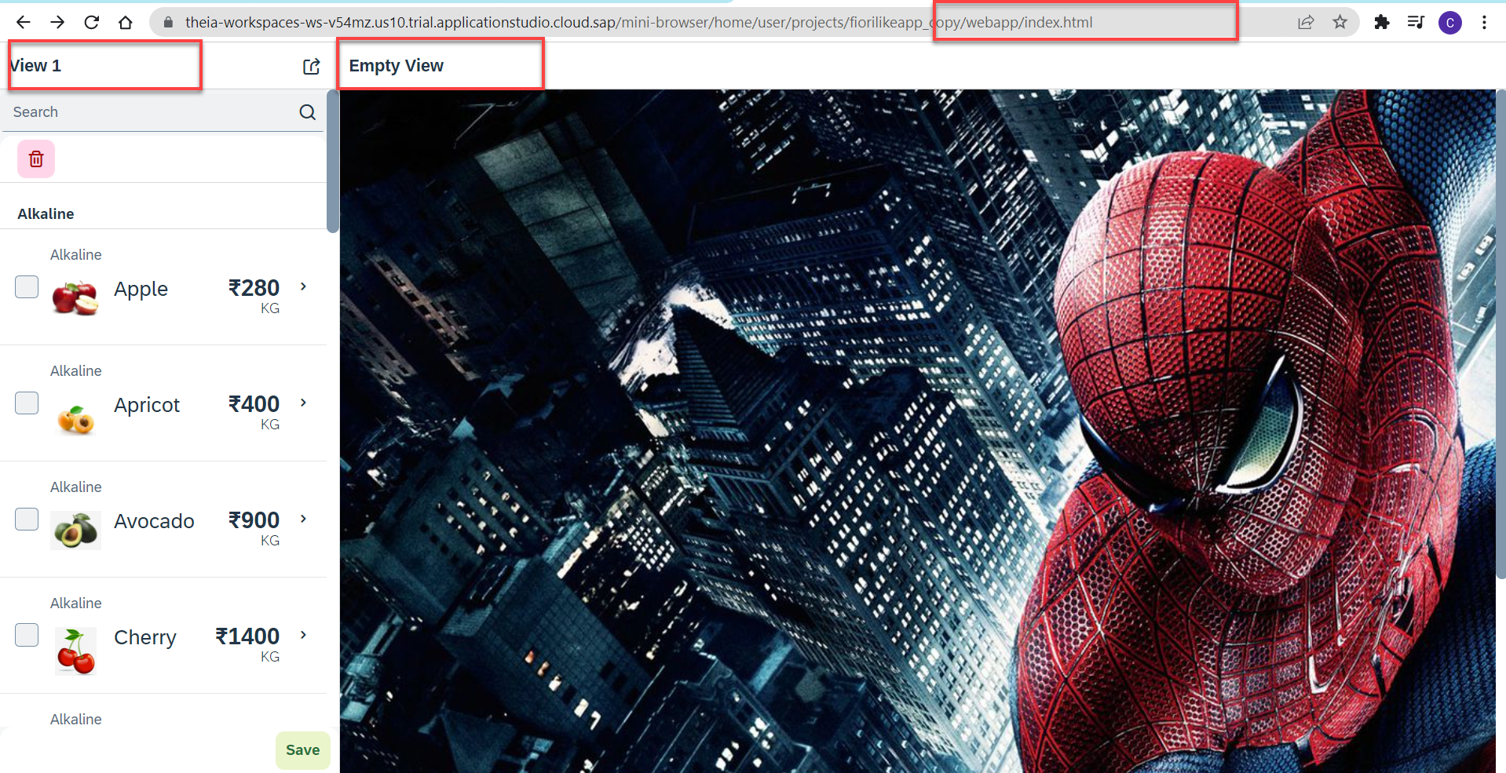
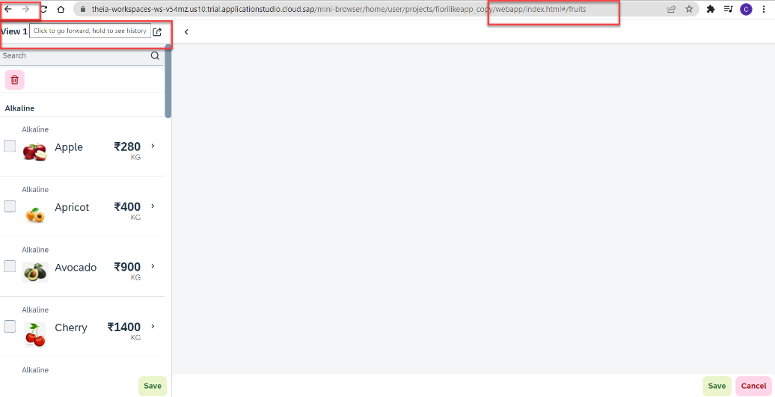
Hands – on: Routing Implementation
Now we need to implement routing in our existing application, for that we have to follow the Steps provided in the previous slides.
We also have to change the navigation in our View1 controller, and make it according to the Router, for that we have to get the router object in the View1 controller and then navigate to the view using the navTo() function.
To get the router object in View1 controller
this.oRouter = this.getOwnerComponent().getRouter();
To navigate to the View2
this.oRouter.navTo("loadMyV2");
Code Links:
manifest.json
Component.js
View1.controller.js

Slide 7
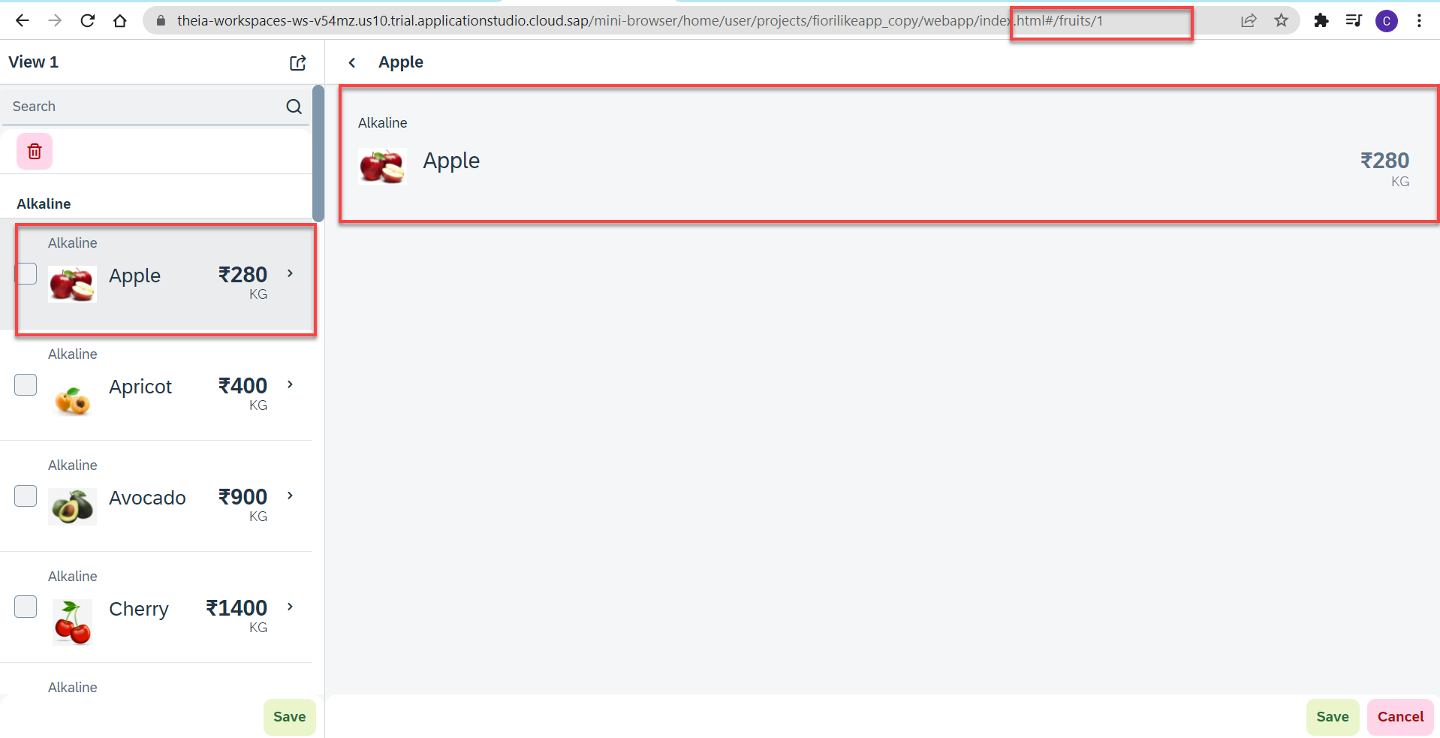
Hands – no: Route Match Handler
Route Match Handler: It is a function which gets triggered every time when Route, End Point, Hash Tag Changes.
Now using the route match handler we will load the data of the selected fruit.
Code Link:-
View1.controller.js
View2.controller.js
manifest.js

Slide 8


We’re committed to empower you to be
Most Desirable Resource
through powerful training solutions.
We build the workforce of the future.
250+
Corporate Clients
30,000+
Learners Trained
25000+
Learners Placed
FREE WEBINARS
Sign up for free webinars with industry experts every fortnight!
Enroll Now!
Contact us today!
https://anubhavtrainings.com/

Slide 9
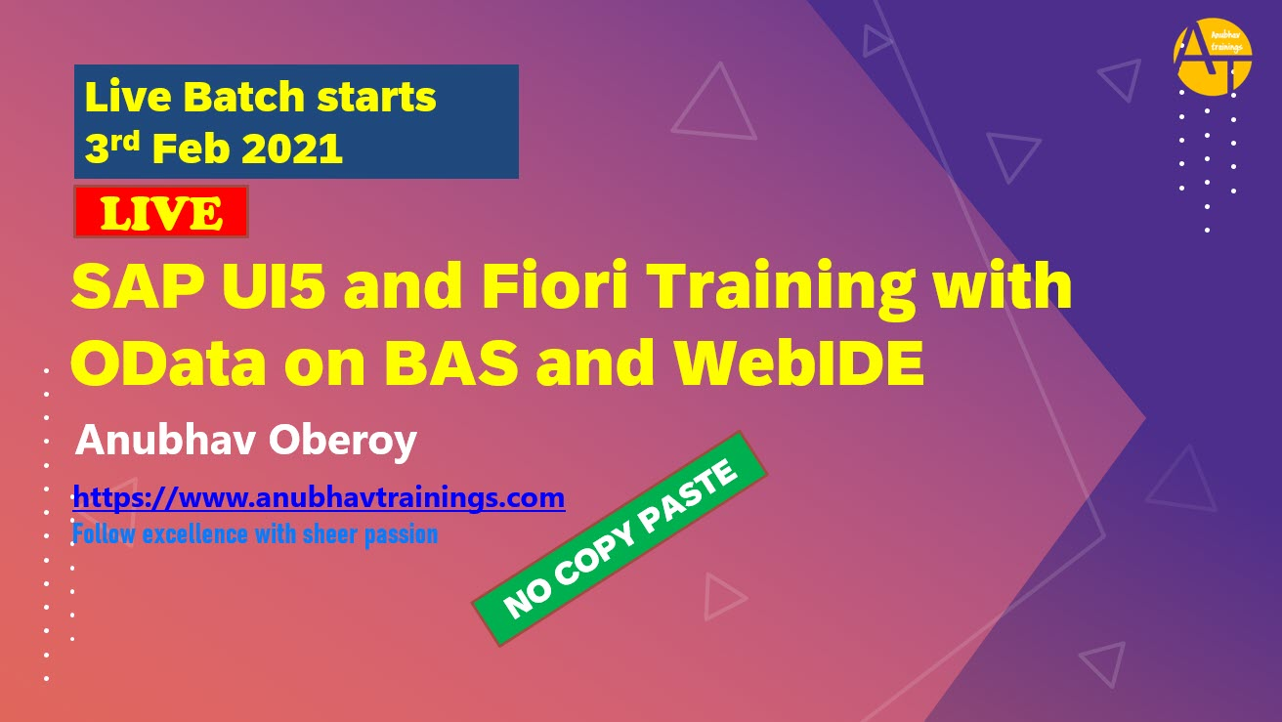
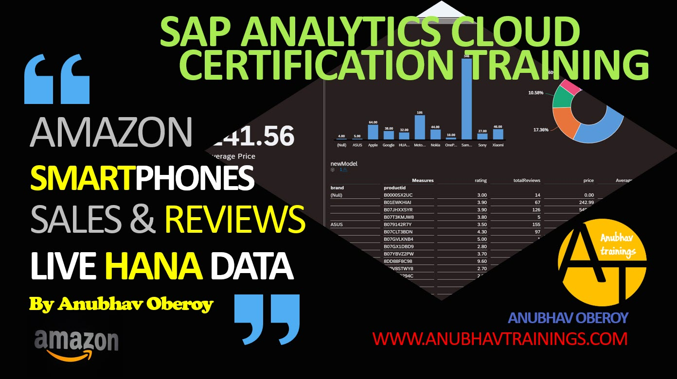
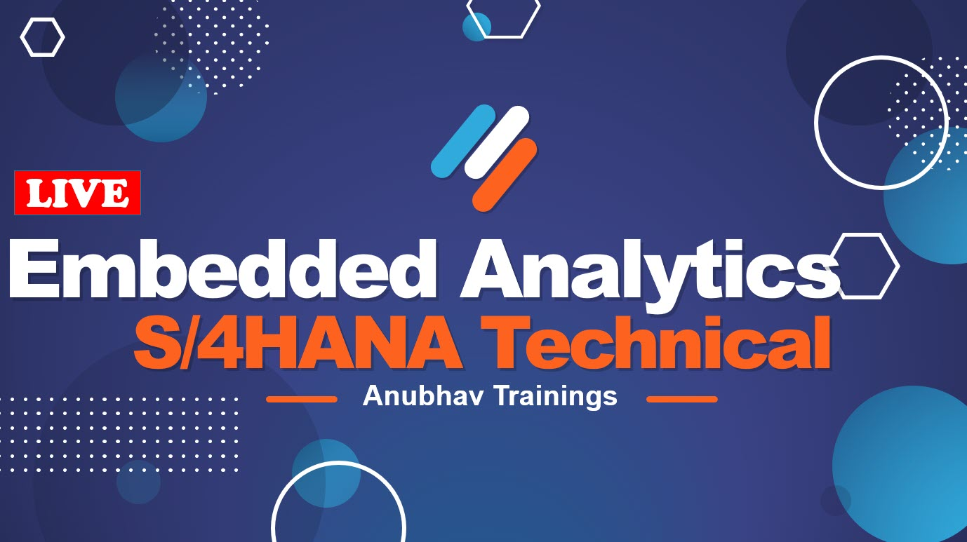
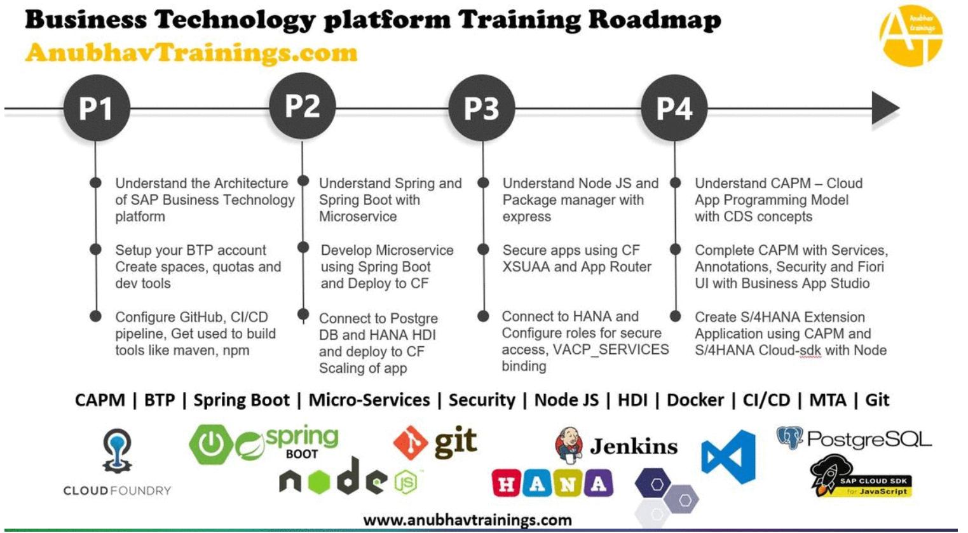
More from AnubhavTrainings.com

Slide 10
Title
Content

